Slide 1
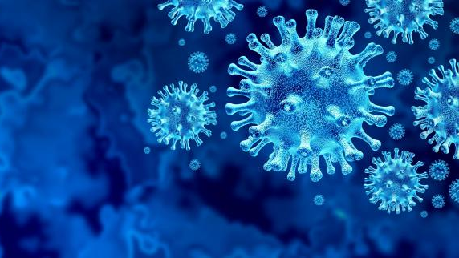
Tracking the COVID19 Outbreak
ETL Project Report By: Prajakta Galvankar & Lujane Abdelgadir

Slide 2

Tracking the COVID19 Outbreak
ETL Project Report By: Prajakta Galvankar & Lujane Abdelgadir

Slide 3

Tracking the COVID19 Outbreak
ETL Project Report By: Prajakta Galvankar & Lujane Abdelgadir

Slide 4

Tracking the COVID19 Outbreak
ETL Project Report By: Prajakta Galvankar & Lujane Abdelgadir

Slide 5

Tracking the COVID19 Outbreak
ETL Project Report By: Prajakta Galvankar & Lujane Abdelgadir

Slide 6
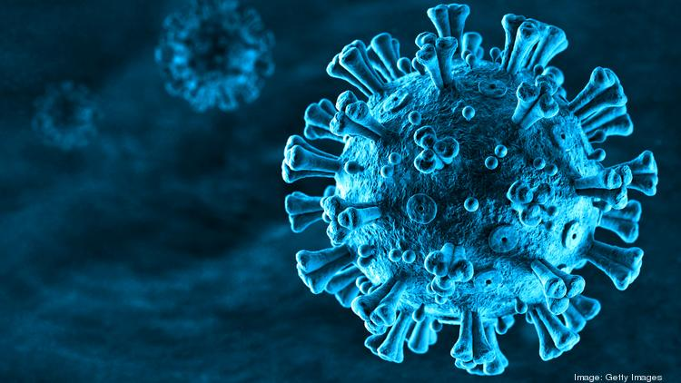
Tracking the COVID19 Outbreak
ETL Project Report By: Prajakta Galvankar & Lujane Abdelgadir

Slide 7
Table of contents
Motivations & Summary
ETL Process summary
Extraction
Transformation
Loading
Analysis & Findings
Conclusions & Limitations

Slide 8

Motivations & Summary

Slide 9
Motivations & Summary

Slide 10
ETL Process summary

Slide 11
ETL Process summary

Slide 12
ETL Process: Extraction

Slide 13
ETL Process: Transformation

Slide 14
ETL Process: Loading

Slide 15
Analysis and Findings

Slide 16
Analysis and findings

Slide 17
Conclusion and Limitations

Slide 18
Conclusion and Limitations

Slide 19
Thank you!

